Slide 1


Slide 2
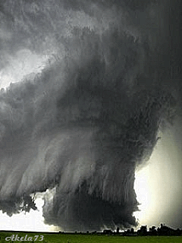
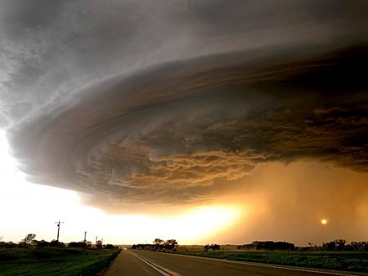
What can you see?

Slide 3
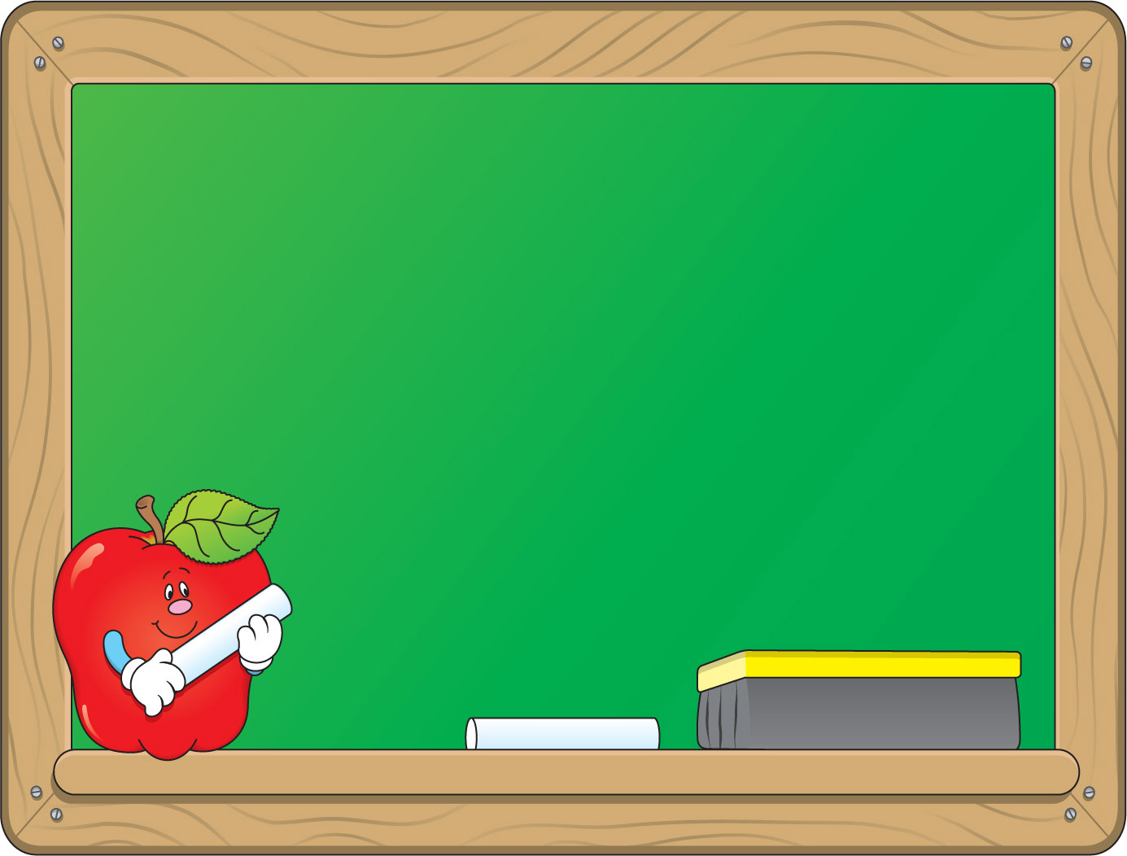
Monday, February 26th 2018
Review 3:
Period 77- Lesson 2: Skills

Slide 4
Monday, February 26th 2018
Review 3:
Period 82- Lesson 2: Skills
I. Reading

Slide 5
1. Read the text and choose the correct answer A, B, C, or D for each question.
HURRICANE KATRINA
New Orleans, in Louisiana, is known as the most unique city in the United States with distinctive architecture, cross-cultural heritage and annual music festivals. However, due to its location along the Mississippi River with lakes on the other side, and nearly half of the city below sea level, the city faces the danger of ﬂ ooding. So, a levee system and drainage canals were built to
protect the city.
Early in the morning of August 29, 2005, Hurricane Katrina, the most destructive natural disaster in the history of New Orleans, struck the city. The storm brought strong winds and heavy rains for several days. As a result, water from the river and lakes rose, breaking the levees and poured directly into the city. Soon 80 percent of the city was under the water. People scrambled to rooftops for safety, desperate for food and drinking water. The winds were so strong that even beds in Hyatt Hotel were seen ﬂ ying out of the hotel windows. The loss was tremendous. Most of the major roads and bridges were destroyed, and houses collapsed. Nearly 2,000 people were killed. After the storm, several natural grounds for the breeding and migrating of diﬀ erent species of animals and birds were permanently lost

Slide 6
1. New Orleans is famous for ______.
A. its modern architecture B. its cross-cultural heritage
C. its Mississippi River D. its location
2. Which statement is NOT correct about New Orleans?
A. It lies between the Mississippi River and lakes.
B. One of its attractions is its annual music festivals.
C. The city is surrounded by water.
D. Most of the city is below sea level.
3. Which one is NOT mentioned as being damaged by Hurricane Katrina?
A. Distinctive architecture B. The levee system
C. Major roads D. Houses
4. The word ‘tremendous’ means ______.
A. puzzling B. huge C. unique D. legendary
5. The word ‘permanently’ is similar to ______.
A. temporarily B. partially C. forever D. rarely

Slide 7
Monday, February 26th 2018
Review 3:
Period 82- Lesson 2: Skills
I. Reading
II. Speaking

Slide 8
2. Work in pairs. Choose one of the topics and make a short conversation.
Topics
1. A place in English speaking countries you would like to visit.
2. An English speaking country which has a close relationship with Viet Nam.
3. A type of disaster which frequently attacks your area.
4. A type of natural disaster which threatens areas along the coast.
5. A human activity which increases pollution
Example:
A: What is the most serious type of pollution in your area?
B: Visual pollution.
A: Can you give an example?
B: Sure. People stick advetisement on walls.
A: Can you do any thing to reduce it?
B: Not much. Once we tear off one advertisement, there will be more of them.
A: Oh! That’s terrible!

Slide 9
Monday, February 26th 2018
Review 3:
Period 82- Lesson 2: Skills
I. Reading
II. Speaking
III. listening

Slide 10

3. Listen to Nguyen talking with his friend Phong, who has just come back from a visit to Singapore and decide if the sentences are true (T) or false (F).
T
F
1. Driverless cars already exist.
2. They look so cool!
3. A jet pack doesn’t take lots of space.
4. Then perhaps a teleporter is the best.
5. Solar energy will power everything!
6. Both the school and the family are responsible for teaching children how to behave in society
✓
✓
✓
✓
✓
✓

Slide 11
Monday, February 26th 2018
Review 3:
Period 82- Lesson 2: Skills
I. Reading
II. Speaking
III. listening
IV. writing

Slide 12
4. The school is organising FIGHT POLLUTION DAY to raise students’ awareness of the dangers of pollution. Choose one activity you would like your friend to participate in and write to him/ her introducing it.
Activity | Time | Place | Job description
Community work | 8.30 - 12.00 | In neighbourhoods of the community | Pick up trash Clear ponds and streams Sort trash for recycling
Poster designing | whole day | At school library | Preparation: take pictures of polluted places in the neighbourhood Design posters warning people of the dangers of pollution and call for action to protect the environment.
Greenisation | 8.00 - 12.00 | In community park and along the sides of community paths | Plant trees and ﬂowers, water them and set up fences to protect them
Talks | 9.00 - 10.00 4.00 - 5.00 | Three residential areas in the community | Public presentations about what to do to create a pollution-free area

Slide 13

IV. Homework
- Practice the dialogue, learn by heart vocabulary.
- Do the exercises in the work book B1.
- Prepare the new lesson: Unit :10 Lesson 2: A closer look 1

